Slide 1
ASE 230 Final
Jason, Tyler, Suman

Slide 2
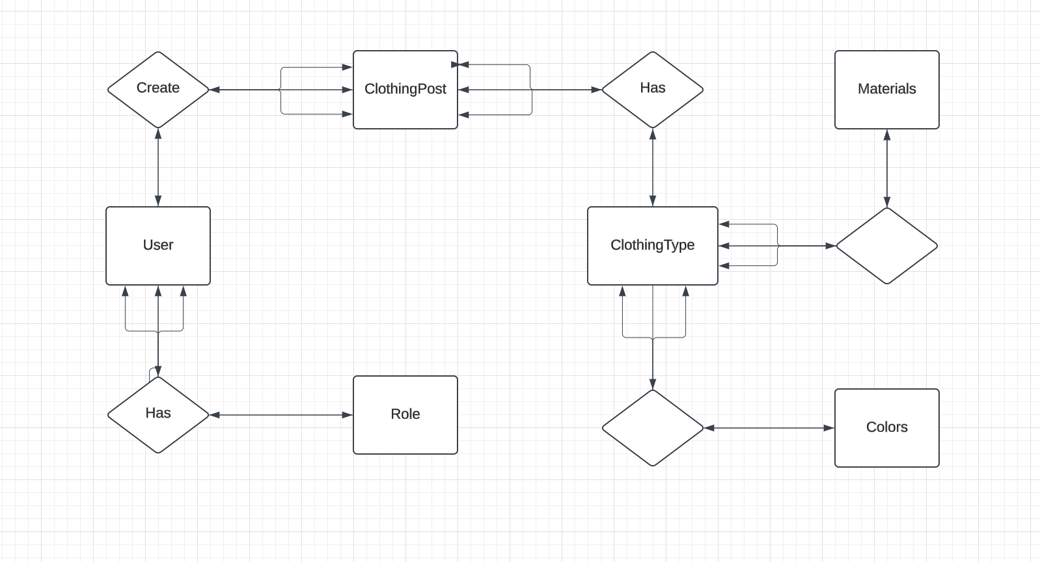
ERD

Slide 3
The project idea
This application serves as a wardrobe management tool (CMS) where users can organize, analyze, and optimize their clothing collection. The core functionality revolves around users being able to upload, categorize, and manage their wardrobe items by various attributes like color, material, and clothing type.

Slide 4
Contributions
Jason Sand:
Created & Implemented the database based on ERD
Moved all the pages from file based database based
Made db_connections.php to facilitate connection to the new database
Handled util.php to create new functions to interact with the database
Created the admin are which allows an admin to CRUD any of the database
Specifically the CR&D Functions

Slide 5
Contributions
Tyler:
Designed the ERD
Handled putting the Navbar and similar CSS in one file to include at the tops of all pages
Completed the overall UI

Slide 6
Contributions
Suman
Helped with admin.php (making the save button work)
Designed the navbar
Implemented original UI

